Slide 1
Understanding advertising
Task A: Comparing promotions
1) Use two different methods to show that packs of 6 rolls are better value for money than packs of 4 rolls.
4 pack of soft rolls
90 p
6 pack of soft rolls
£1.20
2) Aisha needs 500 g of mushrooms for a recipe which feeds 2 people.
Mushrooms 150 g
80 p
Mushrooms 400 g
£1.10
Mushrooms 600 g
£1.80
a) For each pack, what is the price per 100 grams?
b) What would be the cheapest way to buy enough mushrooms to feed 2 people?
c) What would be the cheapest way to buy enough mushrooms to feed 4 people?
d) What would be the cheapest way to buy enough mushrooms to feed 8 people?

Slide 2
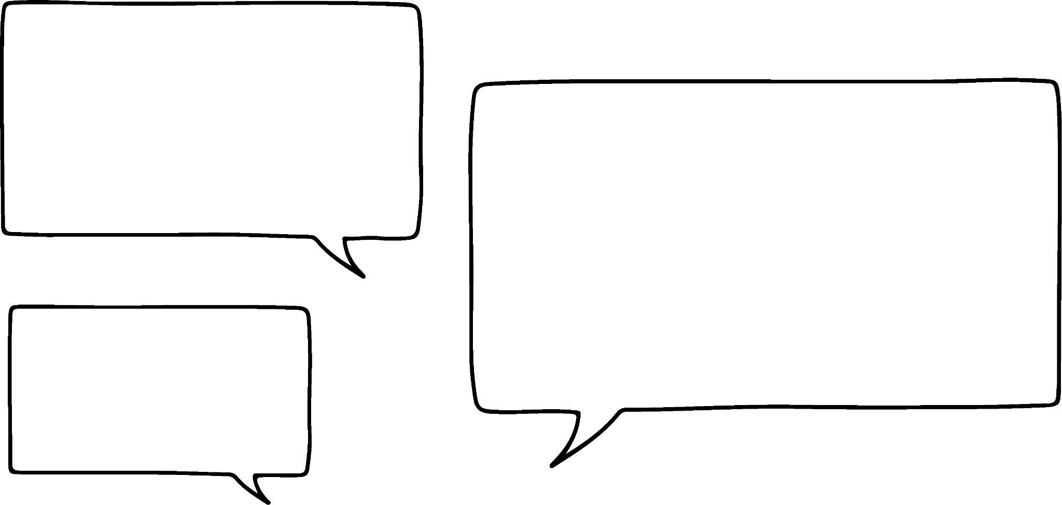

Understanding advertising
3) Which of these promotions are good value for money? Explain your answer.
Pears
39 p each
3 for £1
Ice cream tubs
£5.30 each
Any 4 for £21
Veggie sausages
£2.30 each
Any 3 for £7
4) Lucas sees this promotion in a supermarket.
Fizzy orange
£1.80 each
Buy 1 get 1 half price
When I was in here last week they cost £1.30 each but there was no promotion.
Does this promotion offer a better deal than the price Lucas saw last week?

Slide 3
Understanding advertising
Task B: Unit pricing
1) Which of these unit pricings are correct?
a)
Strawberries (400 g)
£1.89
£4.73 per kg
c)
Silverskin onions (440 g)
79 p
31 p per 100 g
b)
Twin pack Mango
£1.79
89 p each
d)
Wrapping foil (20 m)
99 p
4 p per metre
2) Which of these is the best value for money?
Crisps 6 pk × 25 g
£1.25
0.83 p per gram
Crisps 4 pk × 30 g
£1
25 p each
Crisps 15 pk × 30 g
£3.80
£0.84 per 100 g

Slide 4
Understanding advertising
Task C: Analysing adverts
1) A ‘low sugar’ box of muesli advertises 20% less sugar.
Low sugar
a) How much sugar would be in 100 g of low sugar muesli?
Normal muesli
muesli
b) If a teaspoon is 4.2 grams how many teaspoons of sugar are in a 30 gram serving of low sugar muesli?
Energy
Fat
Saturates
Sugars
375 Kcal
6.2 g
0.9 g
20 g
Amounts Per 100 g
c) A different brand of muesli advertises 5.5 g of sugar per 40 gram serving. Which muesli has the least sugar?
2) Roy’s rides makes and sells motorbikes. Their advert claims:
Our motorbikes hold their value much better than our competitors.
a) The average depreciation of the value of a motorbike in its first year is 20%. What would a motorbike worth £2500 new be worth after one year?
Here are the figures for the value of a motorbike from Roy’s rides and a motorbike from their nearest competitor.
 | Roy’s rides
New | £1800
1 yr old | £1350
 | Competitor
New | £5200
1 yr old | £4420
b) Give a statistic to support the claim made by Roy’s rides
c) Give a statistic which does not support the claim.
Mathematics in Education and Industry
v2.4

